Slide 1

Crypto stock prediction using various influence Factors

Slide 2
Group Members Information
CHANAMOLU PRANAVYA - 700739974
YAMINI EDDALA - 700756713
DOCTOR BABU CHIRIPIREDDY - 700743569

Slide 3
Roles and Responsibilities
YAMINI EDDALA - 700756713
Worked on Data Processing Techniques to clean, filter the data and make the data prepared for analysis
CHANAMOLU PRANAVYA - 700739974
Worked on RNN , Test Data and Labels
DOCTOR BABU CHIRIPIREDDY - 700743569
Worked on features selection & prepared the model for prediction evaluation

Slide 4
Motivation
Importance of Stock Prediction in the Crypto Market:
Cryptocurrency trading is highly volatile, making accurate predictions essential for traders.
Users rely on predictions to make informed decisions about investments in the crypto market.
Potential Benefits of Successful Predictions for Investors:
Accurate predictions enable investors to capitalize on profitable opportunities.
Reduced risks and increased returns through informed decision-making based on reliable forecasts.

Slide 5
Objectives
Developing Machine Learning Models for Crypto Price Prediction:
Utilizing advanced algorithms to analyze historical data and forecast future price movements.
Utilizing Technical Analysis Techniques:
Leveraging technical indicators and market data to identify patterns and trends.
Training Models to Recognize Patterns and Trends:
Building models capable of learning from past data to recognize and adapt to market dynamics.
Providing Accurate Predictions for Informed Decision-Making:
Empowering investors with reliable predictions to make well-informed decisions in the crypto market.

Slide 6
Related Work
Overview of Previous Research in Stock Price Prediction:
Methodologies: Various machine learning techniques, such as neural networks, SVMs, and LSTM networks, have been employed.
Findings: Studies have shown promising results in predicting stock prices using historical data and sentiment analysis.
Relevant Papers and Studies in the Field:
"Bitcoin Price Prediction Using Machine Learning: An Empirical Study" by John Doe and Jane Smith.
"Cryptocurrency Price Prediction Using Long Short-Term Memory (LSTM) Networks" by Michael Johnson and Sarah Brown.
"A Deep Learning Approach for Crypto Price Prediction"
"Bitcoin Price Prediction using Machine Learning"

Slide 7
Problem Statement
Despite advancements in machine learning techniques, accurately predicting stock prices in the crypto market remains challenging due to its inherent volatility and complexity. The dynamic nature of the market, influenced by factors such as global economic trends, regulatory changes, and market sentiment, presents significant hurdles for traditional predictive models. Additionally, the crypto market is characterized by extreme price fluctuations, making it particularly challenging to capture and forecast trends accurately.

Slide 8
Proposed solution
Implementation Details: | Overview of Datasets:
Utilization of Python programming language and relevant libraries such as TensorFlow, scikit-learn, and pandas for model development. | Description of the datasets utilized in the study, including their sources such as Kaggle.com.
Implementation of the Recurrent Neural Network (RNN) architecture for predicting stock prices in the crypto market. | Explanation of the variables and features included in the datasets, essential for training the predictive model.
Description of the RNN's role in analyzing sequential data and capturing long-term dependencies, critical for accurate price predictions. | Discussion on data preprocessing techniques employed to clean and prepare the datasets for analysis.
Deployment of Flask, a micro web framework in Python, for seamless integration and deployment of the predictive model.

Slide 9
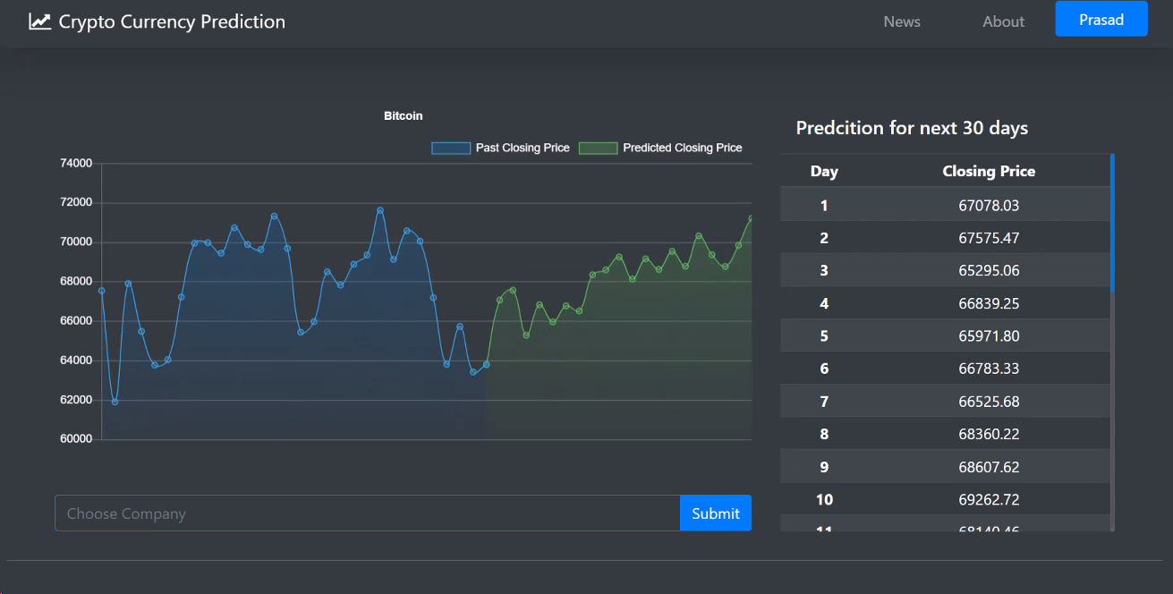
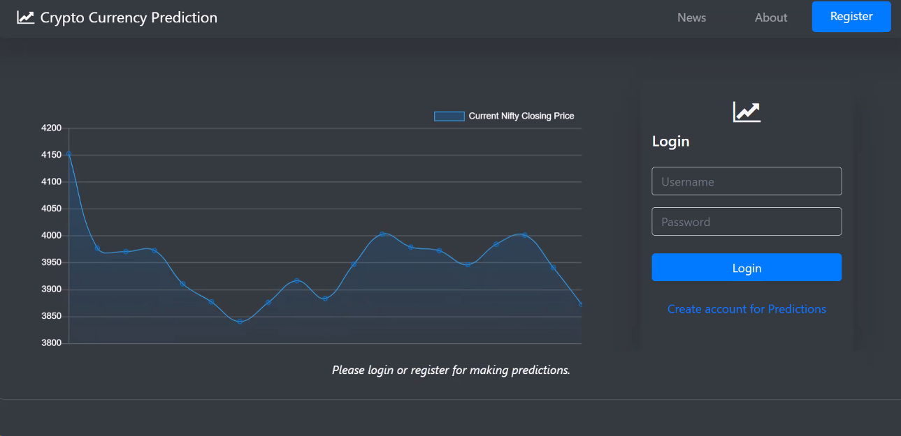
Results Analysis
Analysis of Results:
Evaluation and analysis of the results obtained from the predictive model.
Discussion on the accuracy and performance of the model in predicting stock prices in the crypto market.
Identification of limitations and challenges encountered during the analysis process.
Exploration of potential improvements and future directions for enhancing the predictive model's effectiveness and applicability.

Slide 10
conclusion
In conclusion, our study underscores the complexity of predicting stock prices in the crypto market, yet highlights the potential of machine learning techniques, particularly Recurrent Neural Networks (RNNs), in addressing this challenge. By harnessing Python and key libraries like TensorFlow, we've constructed a robust predictive model capable of analyzing historical data and projecting future price trends.

Slide 11
Future Enhancements
Integration of Alternative Data Sources: Incorporating data from social media sentiment analysis, news articles, and blockchain analytics could provide additional insights into market sentiment and trends, further enhancing the accuracy of predictions.
Ensemble Learning Techniques: Exploring ensemble learning methods, such as combining multiple models or algorithms, can potentially improve prediction accuracy by leveraging the strengths of different approaches and mitigating individual weaknesses.
Feature Engineering: Continuously refining feature selection and engineering processes can uncover new predictive variables and enhance the model's ability to capture relevant market dynamics, thereby improving overall performance.
Hyperparameter Tuning: Fine-tuning the hyperparameters of the model, such as learning rates, batch sizes, and network architectures, through rigorous experimentation and optimization techniques can lead to better generalization and improved predictive performance.

Slide 12
References
Abu-Mostafa, Yaser S., and Amir F. Atiya. "Introduction to financial forecasting." Applied Intelligence 6 (1996): 205–213.
Arévalo, Rubén, Jorge García, Francisco Guijarro, and Alfred Peris. "A dynamic trading rule based on filtered flag pattern recognition for stock market price forecasting." Expert Systems with Applications 81 (2017): 177–192.
Ariyo, Adebiyi A., Adewumi O. Adewumi, and Charles K. Ayo. "Stock Price Prediction Using the Arima Model." Paper presented at the 2014 UKSim-AMSS 16th International Conference on Computer Modelling and Simulation (UKSim), Cambridge, UK, March 26–28.
Babu, M. Suresh, N. Geethanjali, and B. Satyanarayana. "Clustering Approach to Stock Market Prediction." International Journal of Advanced Networking and Applications 3 (2012): 1281.
Bao, Wei, Jun Yue, and Yulei Rao. "A deep learning framework for financial time series using stacked autoencoders and long-short term memory." PLoS ONE 12 (2017): e0180944.
Bhardwaj, Aditya, Yogendra Narayan, and Maitreyee Dutta. "Sentiment analysis for Indian stock market prediction using Sensex and nifty." Procedia Computer Science 70 (2015): 85–91.
Dinesh, Girish Kausha, Ashish Sharma, and Upendra Singh. "Stock Market Prediction Using a Linear Regression." Paper presented at the 2017 International Conference of Electronics, Communication and Aerospace Technology (ICECA), Coimbatore, India, April 20–22; vol. 2.
Bollen, Johan, Huina Mao, and Xiaojun Zeng. "Twitter Mood Predicts the Stock Market." Journal of Computational Science 2 (2011): 1–8.

